Slide 1
SQL Loan Classification Data
Credit Scores
Loan Amount by Intent
Highest/Lowest Credit Scores
credit_category | count
Good (>700) | 2694
Average (500-700) | 41795
Poor (<500) | 506
loan_intent | avg_loan_amount
HOMEIMPROVEMENT | 10419.187330127500
VENTURE | 9658.1961110400400000
PERSONAL | 9604.5281419679500000
DEBTCONSOLIDATION | 9548.3336599020300000
EDUCATION | 9506.5989509343200000
MEDICAL | 9137.9591717360800000
min_credit | max_credit
390 | 792
Loan Amount per Income Group
Loan Status
income_category | avg_loan_amount
Middle Income (25K-75K) | 8000.7856912794900000
Low Income (<25K) | 3763.6313423249800000
High Income (>75K) | 12182.924784946200
loan_status | count
0 | 34995
1 | 10000

Slide 2
Highest Loans Approved
person_age | person_gender | person_education | person_income | person_emp_exp | person_home_ownership | loan_amnt | loan_intent | loan_int_rate | loan_percent_income | cb_person_cred_hist_length | credit_score | previous_loan_defaults_on_file | loan_status
25 | female | Master | 202525 | 1 | MORTGAGE | 35000 | PERSONAL | 10.65 | 0.17 | 2 | 589 | Yes | 0
22 | male | High School | 193337 | 0 | MORTGAGE | 35000 | MEDICAL | 10.65 | 0.18 | 4 | 602 | Yes | 0
25 | female | High School | 277017 | 4 | MORTGAGE | 35000 | MEDICAL | 13.99 | 0.13 | 4 | 622 | Yes | 0
23 | male | Bachelor | 333399 | 1 | OWN | 35000 | PERSONAL | 11.01 | 0.1 | 4 | 609 | No | 0
24 | male | High School | 222629 | 0 | MORTGAGE | 35000 | EDUCATION | 12.42 | 0.16 | 2 | 623 | No | 0
23 | male | Bachelor | 258980 | 0 | MORTGAGE | 35000 | MEDICAL | 14.79 | 0.14 | 3 | 618 | Yes | 0
23 | male | Bachelor | 144943 | 0 | RENT | 35000 | EDUCATION | 7.9 | 0.24 | 4 | 663 | No | 0
23 | female | Associate | 138998 | 0 | RENT | 35000 | EDUCATION | 7.9 | 0.25 | 4 | 583 | No | 0
25 | male | Bachelor | 195718 | 0 | RENT | 35000 | VENTURE | 7.49 | 0.18 | 4 | 684 | Yes | 0
23 | female | Associate | 192873 | 0 | MORTGAGE | 35000 | PERSONAL | 7.66 | 0.18 | 2 | 684 | Yes | 0

Slide 3
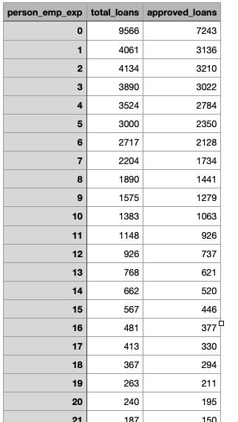
Loan Approval Data
Loan Approval by Education
Loan Approvals by Employment
person_education | total_loans | approved_loans | rejected_loans
Doctorate | 621 | 479 | 142
High School | 11971 | 9300 | 2671
Associate | 12026 | 9376 | 2650
Bachelor | 13397 | 10379 | 3018
Master | 6980 | 5461 | 1519
Loan Approval by Income
income_category | total_loans | approved_loans | rejected_loans
Low Income (<25K) | 1557 | 349 | 1208
Middle Income (25K-75K) | 24838 | 18300 | 6538
High Income (>75K) | 18600 | 16346 | 2254
Loan Approval by Home Ownership
person_home_ownership | total_loans | approved_loans | rejected_loans
MORTGAGE | 18487 | 16343 | 2144
RENT | 23440 | 15845 | 7595
OTHER | 117 | 78 | 39
OWN | 2951 | 2729 | 222

